Slide 1
Basics of DBMS

Slide 2
DBMS
Database Management System
Term Database requires understanding of data and information

Slide 3
Difference between Data and Information?

Slide 4
Database Management System
Term Database requires understanding of data and information
• Data: It can be anything like name, place or number, etc. Data usually refers to raw data, or unprocessed data.
•Information: It is organized or classified data so that it has some meaningful values to the receiver.
– Information is the processed data on which decisions and actions are based.

Slide 5
Is the following text data or information?
INT 306
Data
Information

Slide 6
Course code- INT 306
a) data
b) Information

Slide 7
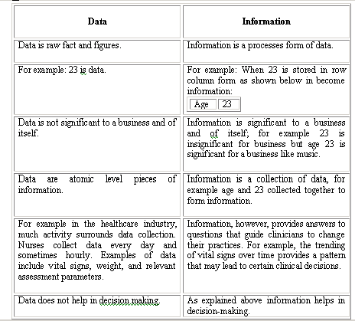

Slide 8
Database
The related information when placed in an organized form makes a database.
The organization of data/information is necessary because unorganized information has no meaning.

Slide 9
Operations on Databases
To add new information
To view or retrieve the stored information
To modify or edit the existing
To remove or delete the unwanted information
Arranging the information in a desired order etc.

Slide 10
Manual database and its problems
Wastage of
skills and
intelligence
of human
beings on
repetitive calculations.
Error prone.

Slide 11
Database and Computers
•Large storage capacity
•It has high speed
•Computer is more accurate.
•There are two approaches for storing data in computers such as File based approach and Database approach.

Slide 12
File Based Approach
A file system is a method for storing and organizing computer files
File systems may use a storage device such as a hard disk or CD-ROM and involve maintaining the physical location of the files.
Programmers used programming languages such as COBOL, C++ to write applications that directly accessed flat files to perform data management services and provide information for users.

Slide 13
Limitations of the File-Based Approach
Data Redundancy and inconsistency
Difficulty in Accessing data
Data Isolation
Integrity problem
Atomicity problem
Concurrent Access anomalies

Slide 14
Database Approach
A database is a computer based record keeping system whose over all purpose is to record and maintain information. The database is a single, large repository of data, which can be used simultaneously by many departments and users.

Slide 15
Database Management System (DBMS)
DBMS A database management system is the software system that allows users to define, create and maintain a database and provides controlled access to the data.
A database management system (DBMS) is basically a collection of programs that enables users to store, modify, and extract information from a database as per the requirements.

Slide 16
Who created the first DBMS?
Edgar Frank Codd
Charles Bachman
Charles Babbage
Sharon B. Codd

Slide 17
What was first database invented by Charles Bachman with his team?
Integrated Data Store
SQL
Oracle
IBM DB2

Slide 18
Ques- Tuple is another name for
Row
Column

Slide 19
Examples of Database Applications
The following are main examples of database applications:
Computerized library systems
Automated teller machines
Flight reservation systems
Computerized parts inventory systems
Commercially available Database management systems in the market are dbase, Foxpro, IMS and Oracle.

Slide 20
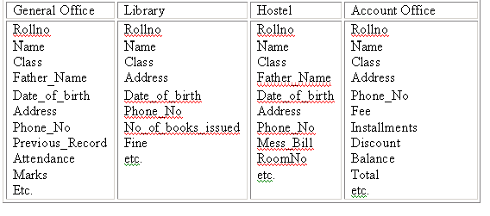
University Database in File Based System

Slide 21
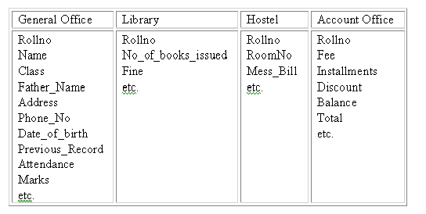
University Database in Database based System

Slide 22
Which of the following is latest version of Oracle?
10g
12c
19c
21c

Slide 23
Advantages of DBMS

Slide 24
Controlling redundancy
Data redundancy is a condition created within a database or data storage technology in which the same piece of data is held in two separate places.

Slide 25
Integrity can be enforced
Integrity of data means that data in database is always accurate, such that incorrect information cannot be stored in database.

Slide 26
Inconsistency can be avoided
When the same data is duplicated and changes are made at one site, which is not propagated to the other site, it gives rise to inconsistency and the two entries regarding the same data will not agree.

Slide 27
Other Advantages
Data can be shared
Providing Backup and Recovery
Restricting unauthorized access

Slide 28
Disadvantages of DBMS
Complexity
Size
Performance
Higher impact of a failure
Cost of DBMS
Additional Hardware costs

Slide 29
Applications of DBMS
Banking: all transactions
Airlines: reservations, schedules
Universities: registration, grades
Sales: customers, products, purchases
Online retailers: order tracking, customized recommendations
Manufacturing: production, inventory, orders, supply chain
Human resources: employee records, salaries, tax deductions

Slide 30
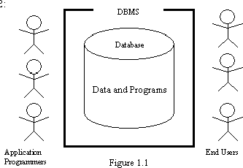
Components of the DBMS Environment
•Hardware
•Software
•Data
•Users
Procedures

Slide 31
Hardware: Computer system used for keeping and accessing the database
Software: The actual DBMS
Allows user to communicate with the database
The mediator between database and users
Data: Most important component from end users point of view
Procedures: Instructions and rules that govern design and use of the database
Log on to the dbms
Start and stop the dbms
Make backup copies of the database

Slide 32
Users: Who can access or retrieve data on demand using applications interfaces provided by DBMS. The users can be:
Naïve users
Application programmers
Sophisticated users
Database designers
Database administrators

Slide 33
Naive / Parametric End Users
Parametric End Users are the unsophisticated who don’t have any DBMS knowledge but they frequently use the database applications in their daily life to get the desired results.
Application Programmers
Application Programmers also referred as System Analysts or simply Software Engineers, are the back-end programmers who writes the code for the application programs. They are the computer professionals.
Sophisticated Users
Sophisticated users can be engineers, scientists, business analyst, who are familiar with the database. They can develop their own database applications according to their requirement. They don’t write the program code but they interact the database by writing SQL queries directly through the query processor.

Slide 34
Database Designers
Data Base Designers are the users who design the structure of database which includes tables, indexes, views, triggers, stored procedures and constraints which are usually enforced before the database is created or populated with data. He/she controls what data must be stored and how the data items to be related.
Database Administrator (DBA)
Database Administrator (DBA) is a person/team who defines the schema and also controls the 3 levels of database. The DBA will then create a new account id and password for the user if he/she need to access the database. It is also responsible for providing security to the database.

Slide 35
Ques: While performing a transaction at ATM, You belong to which category of users?
Naïve user
Application Programmer
Sophisticated user
Database administrator

